Slide 1
Found Object Reliquary

Slide 2
Reliquary
A receptacle for keeping or displaying a scared relic(something that has survived the passage of time)
Use of reliquaries became important to Christian religions.

Slide 3
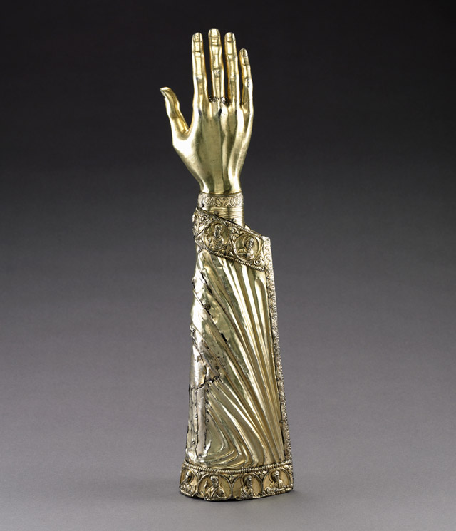

Slide 4
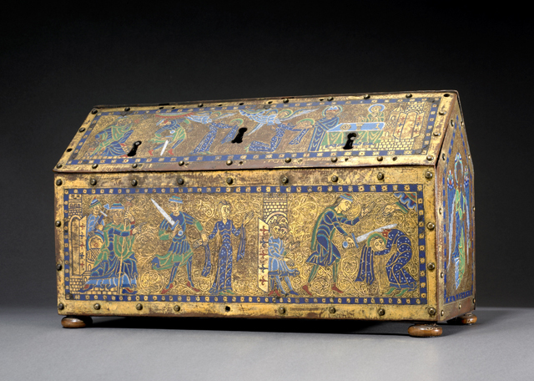

Slide 5
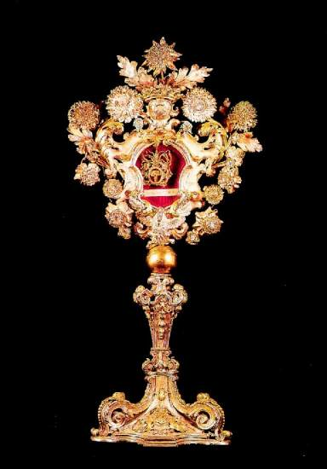

Slide 6
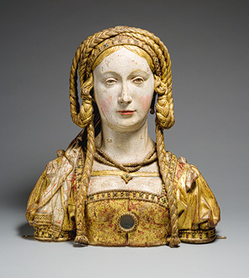

Slide 7
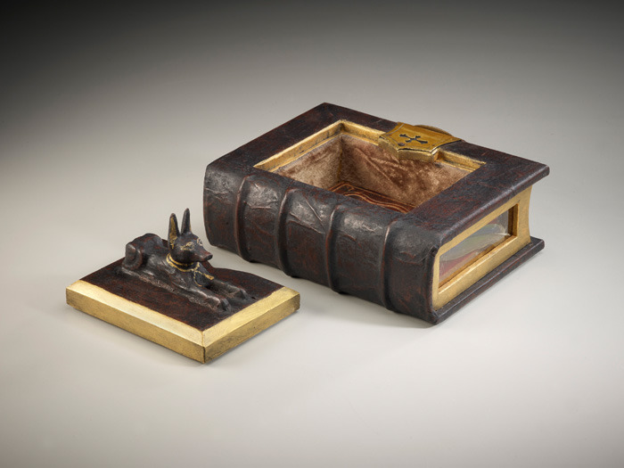
Daniel Essig

Slide 8
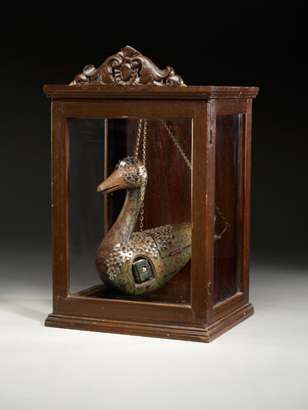

Slide 9
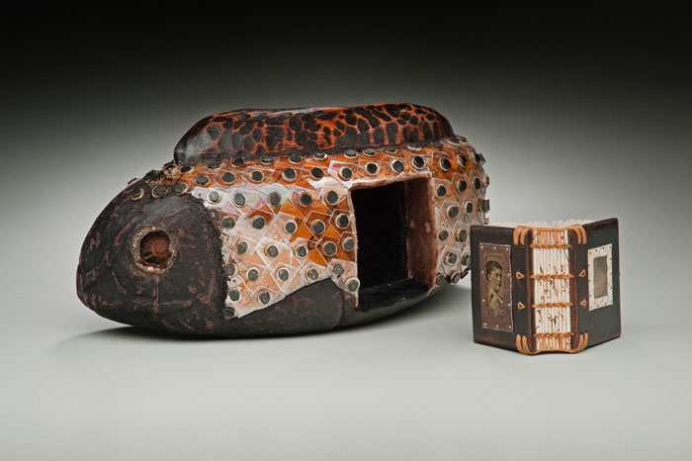

Slide 10
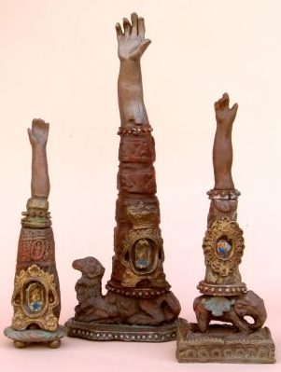
John Hodge

Slide 11
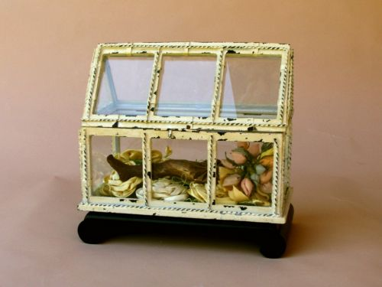

Slide 12
